Slide 1
Microcontroller Based Eight-Channel Sequencer
Team Members:
Ryan Jensen – ryan.jensen-2@mnsu.edu
Josh Roal – joshua.roal@gmail.com

Slide 2
Project Introduction
The Sequencer was designed to create tones according to a programmed sequence in order to create basic music.
The sound signals will be generated by microcontroller.
The user will be able to create and edit the song data by changing the code for the microcontroller.
The channels and sequence will be displayed in a 8x8 LED matrix.
The LED matrix will scroller the sequence across the matrix with the last column being the output.

Slide 3
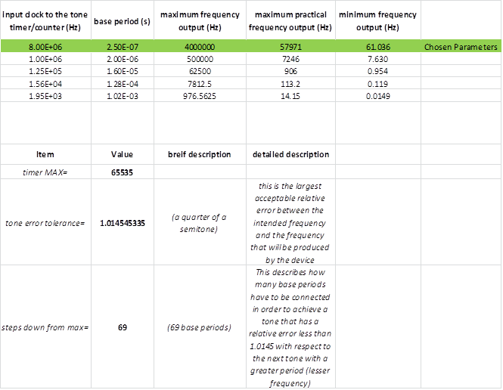
Project Details: Frequency Calculation Table.

Slide 4
Project Specification
The MBS (Microcontroller Based Sequencer) will have eight output channels. Each channel may be either on/off (high/low) output signals, or audio signals.
Of the eight output channels, the channels that are digital outputs will be fed into circuits/devices that will produce sounds/tones.
All of the sounds generated by the microcontroller or generated by the peripheral circuits that the microprocessor controls will be mixed together before reaching the output.
The device must be able to output the synthesized audio to a 1/8” audio jack.
The MBS will have an 8x8 LED matrix that will display the song data to the user.
Each column of the 8x8 LED matrix (MBS-01) will represent an eighth note in each measure. Each row of the matrix will be associated with one of the eight channels.
The song data will be stored in measures. Each measure will be comprised of eight beats. For each beat in the song, there will be a byte of data stored. Each of the eight bits in the byte will correspond to one of the eight sound channels. If a bit it set (1), the sound on that channel will be played. If the bit is unset (0), the sound on that channel will not be played.

Slide 5
Project Specification Continued
The user must be able to manually navigate the song data while visually seeing the song data displayed on the 8x8 LED matrix.
The user must be able to copy and paste entire measures of song data with simple user input.
The user must be able to erase entire measures of song data with simple user input.
The device will be in an enclosure that will be no larger than 18cm long, 22cm wide, and 8cm deep.
The device should weigh no more than 1.5 kg
The device will operate in the temperature range of 0°C to 40°C
The device will be able to produce an assortment of different waveforms at different frequencies. Sine waves, triangle waves, square waves, and ramp waves are all signals that should be able to be produced at a myriad of different frequencies inside human hearing.

Slide 6
Project Budget
Item | Cost of Item ($) | Quantity | Total Cost Of Items ($)
Atmel ATmega328P microcontroller | 2.24 | 1 | 2.24
Atmel ATtiny24A microcontroller | 0.70 | ~4 | 2.80
Atmel AVR Dragon | 52.44 | 1 | 52.44*
LEDs for the 8x8 LED matrix | 0.04 | 64 | 2.56
User interface hardware: buttons, potentiometers, misc LEDs, etc… | -- | -- | 7.50
Audio synth circuit hardware | -- | -- | 7.50
Audio processing hardware | -- | -- | 5.00
COST (minus AVR Dragon programmer): $27.60
COST: $80.04

Slide 7
Conclusion
Timer0 is used to precisely time the beats of the song. The timer starts at 0 and counts up to the value stored in the output-compare register. Once this happens, timer0 resets itself and the song is advanced one beat. So each time timer0 makes a full cycle, the song will advance to the next set of notes.
Most of the project requirements were satisfied through the semester. The device has a proper data architecture, displays song data correctly, and outputs song data as well. The noise generator works as intended and the tone generation is working well. The one thing that was not completed was the user interface. This feature will be a future task for the project.

